Slide 1

FALL DETECTION OF HUMAN BEING AND NOTIFICATION SYSTEM FROM VIDEO FILES
PROJECT GUIDE
MR VIVEK ARYA
(Assistant Professor ECE,FET)
PRESENTED BY
ASHUTOSH KUMAR MISHRA(156320027)
PRATYUSH RATNA(156320051)

Slide 2
TABLE OF CONTENTS
INTRODUCTION
WORKING
ALGORITHM WORKING
CALCULATION OF ORIENTATION
CALCULATION OF SPEED
SENDING SMS TO HOSPITALS
ADVANTAGES
CONCLUSION

Slide 3
INTRODUCTION
In this we build a system using matlab which can detect humans falling on the ground from a CCTV camera feed and so that we can limit the physical damage to the person by alerting the hospital authorities.
Elderly people tend to slip and fall in homes and remain unattended for a long time. If the affected person is not treated immediately, serious health issues including brain injuries occur. The proposed solution automatically detects humans falling, through cameras installed in homes, and sends notification to family members and hospital authorities

Slide 4
WORKING OF PROPOSED MODEL
The heart of this system is computer vision and edge detection algorithm.The video is processed frame by frame in the computer vision algorithm,it draw outline to the edge of the object,that traces the object movement.The algorithm detects the falling of human body by determining all the factors that include instantaneous speed,average speed,area change ,orientation change,average area change ,average orientation change.
When the object changes its speed ,orientation and area above a threshold value as determined in the algorithm,the body is concluded to be fall down.And sms is then send to the family member of the person who fell down,and the hospital authorities are also,informed

Slide 5
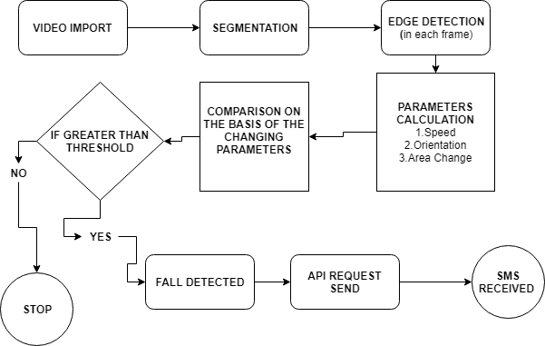
FLOW CHART

Slide 6
ALGORITHM’S WORKING
Importing the video to the project and reading the video using VideoFileReader function.
Detecting the foreground and the background using foreground and blob detector.
Defining the threshold of motion change ,speed change,area change, threshold orientation change and number of fall sequence.
Now iterate through the video at 10fps and determining if an the value changes above the threshold value.
If all the value changes above threshold value in more than 20 consecutive frame the the system detects it as a fall

Slide 7
CALCULATION OF ORIENTATION
function orientation = calcOrientation(ellipse,noiseYxmin)
%calculating degree of rotaion of the image
theta = radtodeg(ellipse(5));
if (yxmin <= ellipse(2)) || ((yxmin <= ellipse(2)+1) && (rx > ry) && ((theta <= noiseYxmin && theta >= 0) || (theta <= (noiseYxmin-90) && theta >= -90)))

Slide 8
if theta >= 0 && theta <= 90
orientation = theta;
elseif theta+90 >= 0 && theta+90 <= 90
orientation = theta+90;
elseif theta+180 >= 0 && theta+180 <= 90
orientation = theta+180;
end
else
if theta >= 90 && theta <= 180
orientation = theta;
elseif theta+90 >= 90 && theta+90 <= 180
orientation = theta+90;

Slide 9
CALCULATION OF SPEED
function [mhimage,speed] = calcSpeed(mhimage,fgBBox,tmhi)
%updating motion history image(mhimg)
mhimage = max(zeros(size(mhimage)),mhimage-1);
mhimage(fgBBox==true) = tmhi;
speed = sum(sum(mhimage))/(sum(sum(fgBBox))*tmhi);
end

Slide 10
SENDING SMS TO THE HOSPITALS
$message = urlencode($text);$curl = curl_init();
curl_setopt($curl, CURLOPT_POST, 1);
curl_setopt($curl, CURLOPT_POSTFIELDS, "apikey=&secret=&usetype=stage&phone=$number&senderid=mrashutosh@gmail.com
&message=$message");
curl_setopt($curl, CURLOPT_HTTPAUTH,
curl_close($curl);

Slide 11
APPLICATIONS
Help elderly peoples who are living alone.
It can help working parents who can not always look after their children.
This system can be modified to do surveillance on the animals.
It can be used to minimise human loss in old age homes.

Slide 12
ADVANTAGES
Help reduce human life losses.
This system can also be modified to work with animals and hence help to reduce animal life as well
Reduce human resource engagement and hence reducing the cost of human resource

Slide 13
CONCLUSION
It can be used to reduce damage to precious human lifes.
Reduce human interference.
Automatic and fast response in time of emergency.

Slide 14
REFERENCES
Cuong Nguyen The & Dmitry Shashev “MATEC Web of Conferences”
D. Shashev, S. Shidlovskiy, V. Syriamkin, A. Yurchenko. “International scientific conference ”
A. Adam, E. Rivlin, I. Shimshoni, and D. Reinitz. “Robust real-time unusual event detection using multiple fixedlocation monitors”. IEEE TPAMI, 30(3):555–560, 2008.

Slide 15
THANK YOU

